Slide 1
DIG4503 Rapid App Web Development
Jon Friskics ©2012

Slide 2
Ajax
Ajax
  The term Ajax coined in the article “Ajax: A New Approach to Web Applications (link) in 2005 by Jesse James Garrett
  Originally an acronym - “Asynchronous JavaScript And XML”
  Now describes a technique for requesting and retrieving data in web applications

Slide 3
Ajax
Ajax – Asynchronous JavaScript and XML
  Asynchronous?
    HTTP requests still occur in a linear way, but the response can be processed in a non-linear way
      The user doesn’t have to wait for the browser
    (It turns out that Ajax applications can be synchronous too)

Slide 4
Ajax
Ajax – Asynchronous JavaScript and XML
  JavaScript?
    Language used mainly by web browsers for client-side scripting
    Interpreted – not compiled
      What’s another example of an interpreted language?
      Interpreted languages don’t show errors until runtime
    All Ajax applications use JavaScript

Slide 5
Ajax
Ajax – Asynchronous JavaScript and XML
  XML?
    eXtensible Markup Language
      Standard format for storing structured data
    It turns out that Ajax applications don’t have to use XML to deliver data from client to server
      JSON, HTML

Slide 6
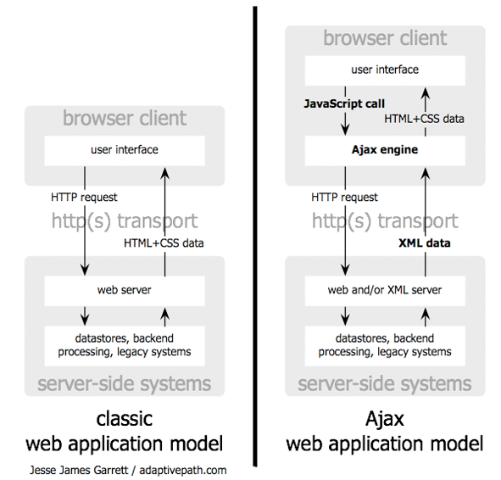

Slide 8
Ajax
Ajax – Asynchronous JavaScript and XML
  Simple Definition
    A way to communicate with a Web server without refreshing the whole page

Slide 9
Ajax
Ajax – Asynchronous JavaScript and XML
  Simple Definition
    A way to communicate with a Web server without refreshing the whole page
      Flash

Slide 10
Ajax
Ajax – Asynchronous JavaScript and XML
  Simple Definition
    A way to communicate with a Web server without refreshing the whole page
      Flash
      Java

Slide 11
Ajax
Ajax – Asynchronous JavaScript and XML
  Simple Definition
    A way to communicate with a Web server without refreshing the whole page
      Flash
      Java
      Frames
      iframe

Slide 12
Ajax
Ajax – Asynchronous JavaScript and XML
  Simple Definition
    A way to communicate with a Web server without refreshing the whole page
      Flash
      Java
      Frames
      iframe
      XMLHttpRequest – JavaScript object that can communicate with a Web server
        We’ll be using this all semester

Slide 13
Ajax
Ajax – Asynchronous JavaScript and XML
  What else?
    Valid, well-formed markup
      XHTML

Slide 14
Ajax
Ajax – Asynchronous JavaScript and XML
  What else?
    Valid, well-formed markup
      XHTML
    Presentation separate from content
      CSS

Slide 15
Ajax
Ajax – Asynchronous JavaScript and XML
  What else?
    Valid, well-formed markup
      XHTML
    Presentation separate from content
      CSS
    DOM Scripting
      JavaScript to control behaviors and change content after the page has already loaded

Slide 16
Ajax
Ajax – Asynchronous JavaScript and XML
  What else?
    Valid, well-formed markup
      XHTML
    Presentation separate from content
      CSS
    DOM Scripting
      JavaScript to control behaviors and change content after the page has already loaded
    Server-side scripting language
      PHP to retrieve data dynamically

Slide 17
References
Keith, Jeremy. Bulletproof Ajax. Berkeley: New Riders, 2007.
Axelson, Knute. coding: The Handbook for Information Technology. Chicago: Blue Line Press, 2005.

